Slide 1
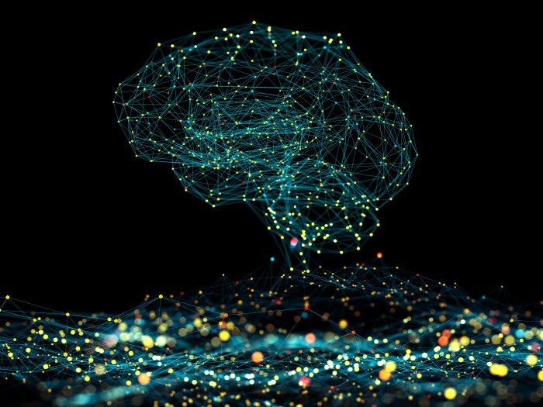
Presentation
Of
Ambient Intelligence
By
Bikram Gyawali

Slide 2
Introduction
Enabling Technology
Topic Content
Application and Use Cases
Benefits and Advantages
Limitation and Challenges
Conclusion

Slide 3
Introduction
Topic Content
Enabling Technology
Application and Use Cases
Benefits and Advantages
Limitation and Challenges
Conclusion

Slide 4
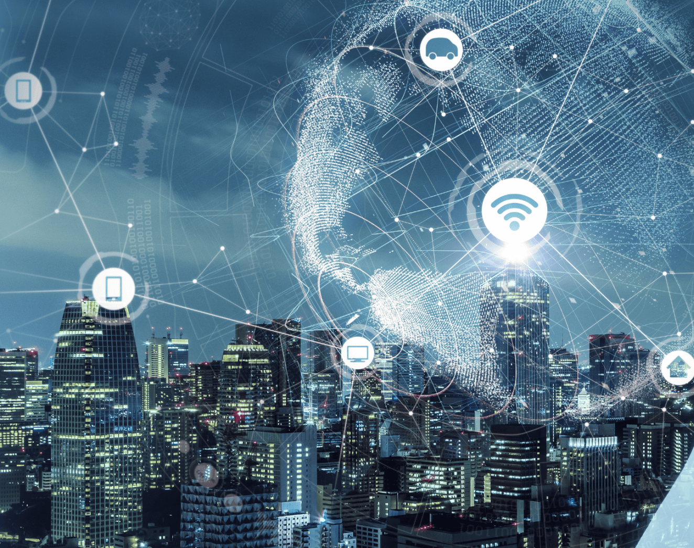
Introduction
Ambient intelligence (AMI) refers to electronic environment that are sensitive and responsive to the presence of people
Ambient intelligence refers to technology that adapts to your surroundings, making everyday environments smarter by sensing, processing, and responding to your needs automatically.

Slide 5
Introduction
Ambient intelligence (AMI) refers to electronic environment that are sensitive and responsive to the presence of people
Ambient intelligence refers to technology that adapts to your surroundings, making everyday environments smarter by sensing, processing, and responding to your needs automatically.
Notes:
The goal of ambient intelligence is to make our lives more comfortable, efficient, and enriched through the invisible integration of smart technologies into the fabric of our everyday surroundings and to make surroundings smarter and more responsive to human needs, enhancing everyday life without requiring explicit commands or interactions.

Slide 6
Introduction
Topic Content
Enabling Technology
Application and Use Cases
Benefits and Advantages
Limitation and Challenges
Conclusion

Slide 7
Artificial Intelligence
Enabling Technology
Sensor Network
Connectivity

Slide 8
Artificial Intelligence
Enabling Technology
Sensor Network
Connectivity

Slide 9
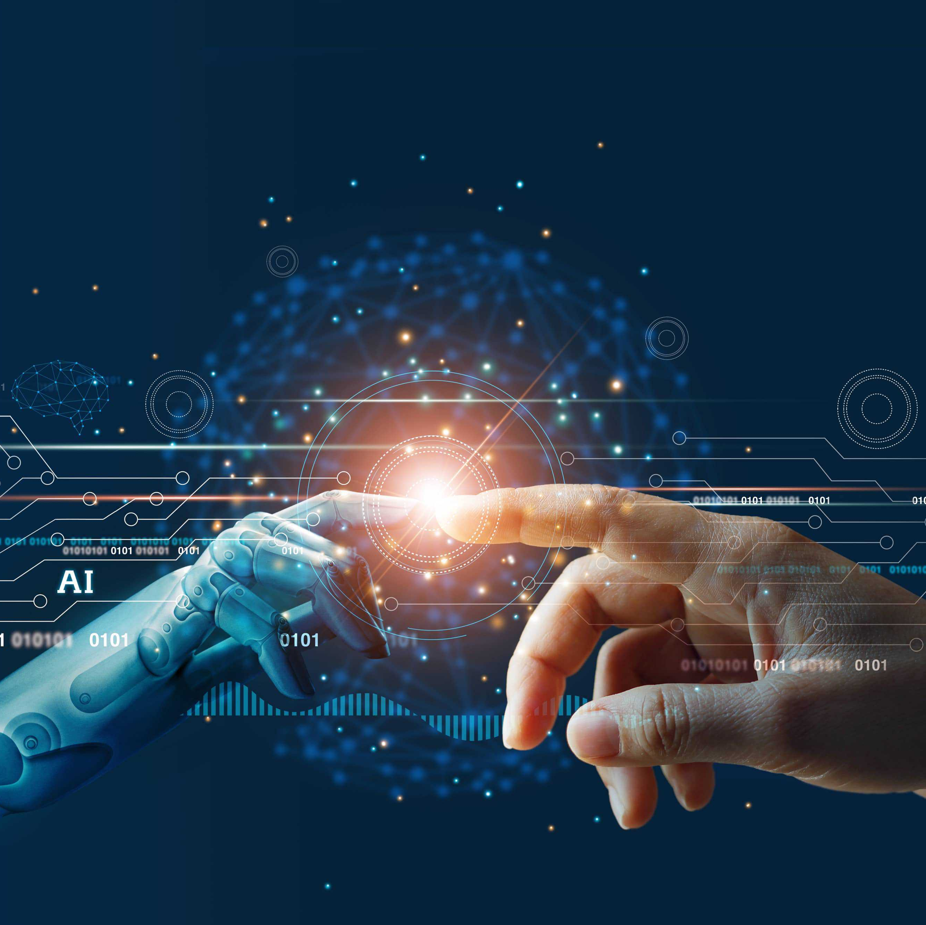
Artificial Intelligence
AI are used to analyze the data collected by sensors and make intelligent decisions about how to respond and adapt the environment accordingly.
Notes:
AI helps to make comfortable environment for the user.For example the AI algorithm help to analyze the temperature of the room and then automatically adjust the temperature of the room according to the user .

Slide 10
Artificial Intelligence
AI are used to analyze the data collected by sensors and make intelligent decisions about how to respond and adapt the environment accordingly.
Notes:
AI helps to make comfortable environment for the user.For example the AI algorithm help to analyze the temperature of the room and then automatically adjust the temperature of the room according to the user .

Slide 11
Artificial Intelligence
Enabling Technology
Sensor Network
Connectivity

Slide 12
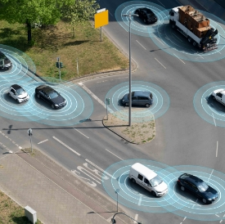
Sensor Network
In ambient intelligence, a sensor network is a group of small devices that can detect and collect information about the environment, such as temperature, light, or motion. These devices work together for the environment surroundings are intelligent and well suited to human needs.

Slide 13
Sensor Network
In ambient intelligence, a sensor network is a group of small devices that can detect and collect information about the environment, such as temperature, light, or motion. These devices work together for the environment surroundings are intelligent and well suited to human needs.

Slide 14
Artificial Intelligence
Enabling Technology
Sensor Network
Connectivity

Slide 15
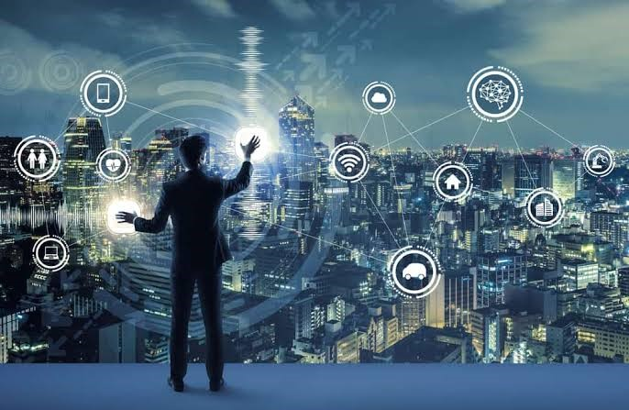
Connectivity
For connectivity many wireless technologies are used such as WIFI and Bluetooth which enables the various devices and sensor use in ambient technology to communicate with each other to performs various tasks.

Slide 16
Connectivity
For connectivity many wireless technologies are used such as WIFI and Bluetooth which enables the various devices and sensor use in ambient technology to communicate with each other to performs various tasks.
Notes:
For example in smart home this technology perform various tasks such as turning light off when the motion sensor detects no activity , maintaining the temperature of the room and all of this tasks are possible only when devices and sensor communicate with each other .

Slide 17
Artificial Intelligence
Enabling Technology
Sensor Network
Connectivity

Slide 18
Introduction
Topic Content
Enabling Technology
Application and Use Cases
Benefits and Advantages
Limitation and Challenges
Conclusion

Slide 19
Smart Home
Application and Use Cases
Health Care
Transportation

Slide 20
Application and Use Cases
Smart Home
Health Care
Transportation

Slide 21
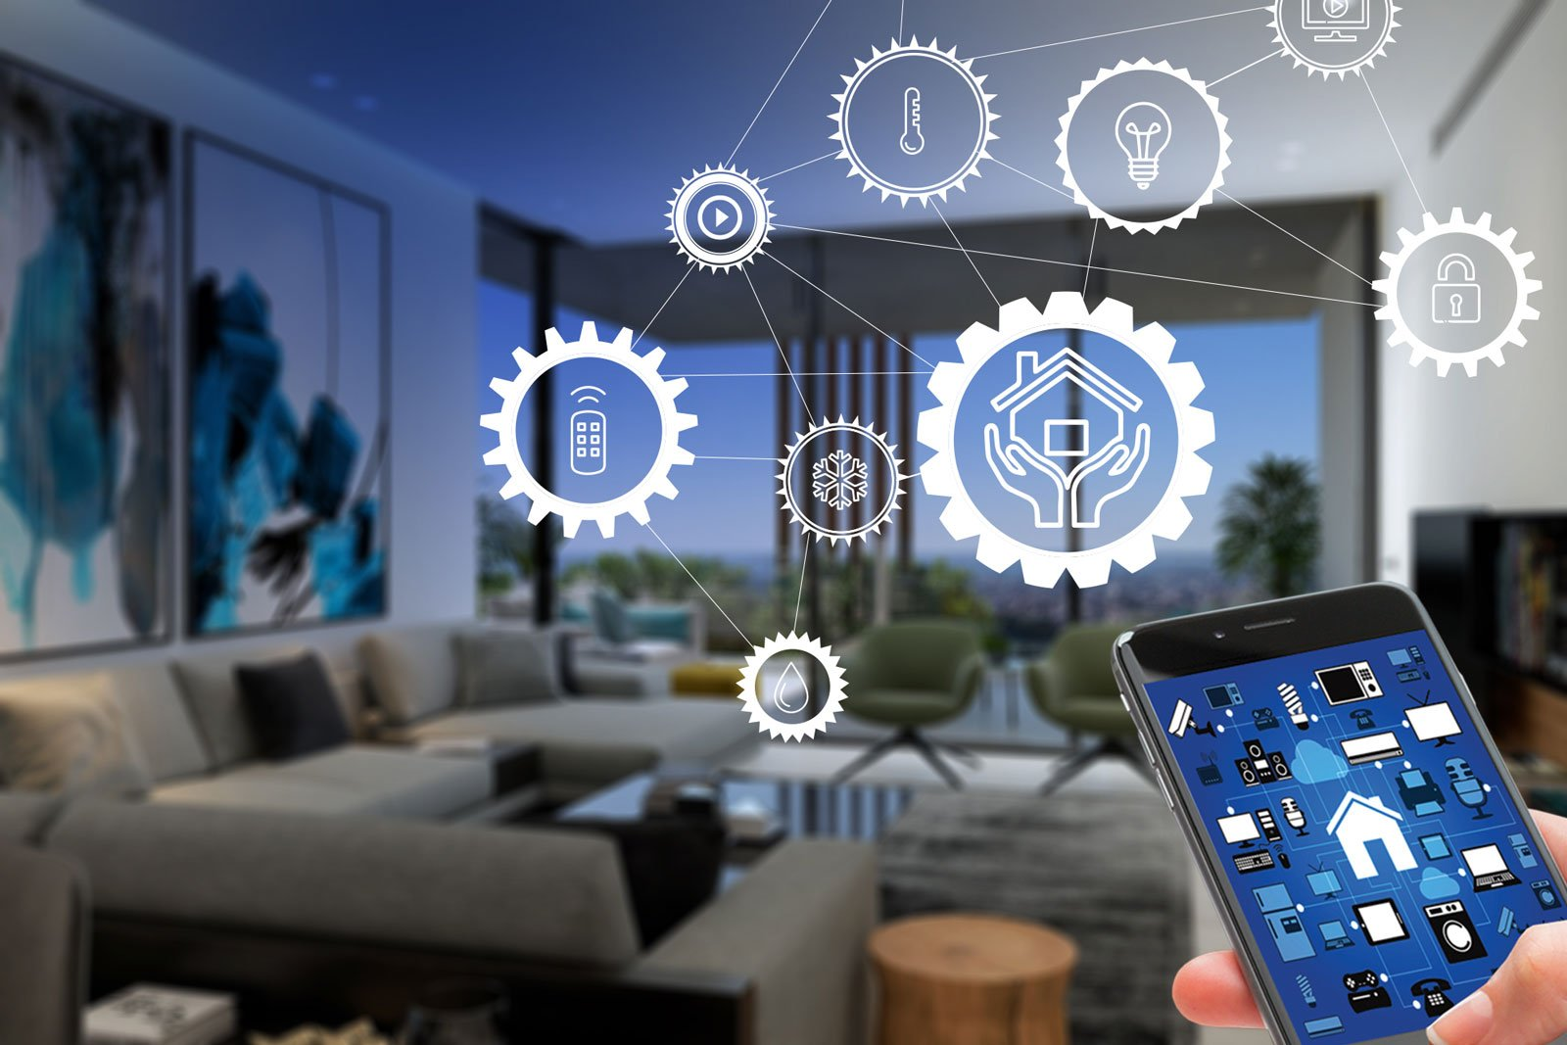
Smart Home
Ambient intelligence can be used to create intelligent, automated homes that can adjust lighting, temperature, security, and other features based on the residents' preferences and daily routines.

Slide 22
Smart Home
Ambient intelligence can be used to create intelligent, automated homes that can adjust lighting, temperature, security, and other features based on the residents' preferences and daily routines.
Notes:
The ambient intelligence turn of the light when no body is present in the room and maintain the temperature of the room by comparing the temperature inside the room and outside of the room

Slide 23
Application and Use Cases
Smart Home
Health Care
Transportation

Slide 24

Health Care
Ambient intelligence systems can be deployed in healthcare settings to continuously monitor patient health, track activities, and alert medical professionals to any concerning changes or emergencies.

Slide 25
Health Care
Ambient intelligence systems can be deployed in healthcare settings to continuously monitor patient health, track activities, and alert medical professionals to any concerning changes or emergencies.
Notes:
Smart Beds: Beds equipped with sensors can detect patient movements, heart rate, and respiratory rate. These data can be continuously monitored to alert medical staff of any signs of distress or abnormality.

Slide 26
Application and Use Cases
Smart Home
Health Care
Transportation

Slide 27
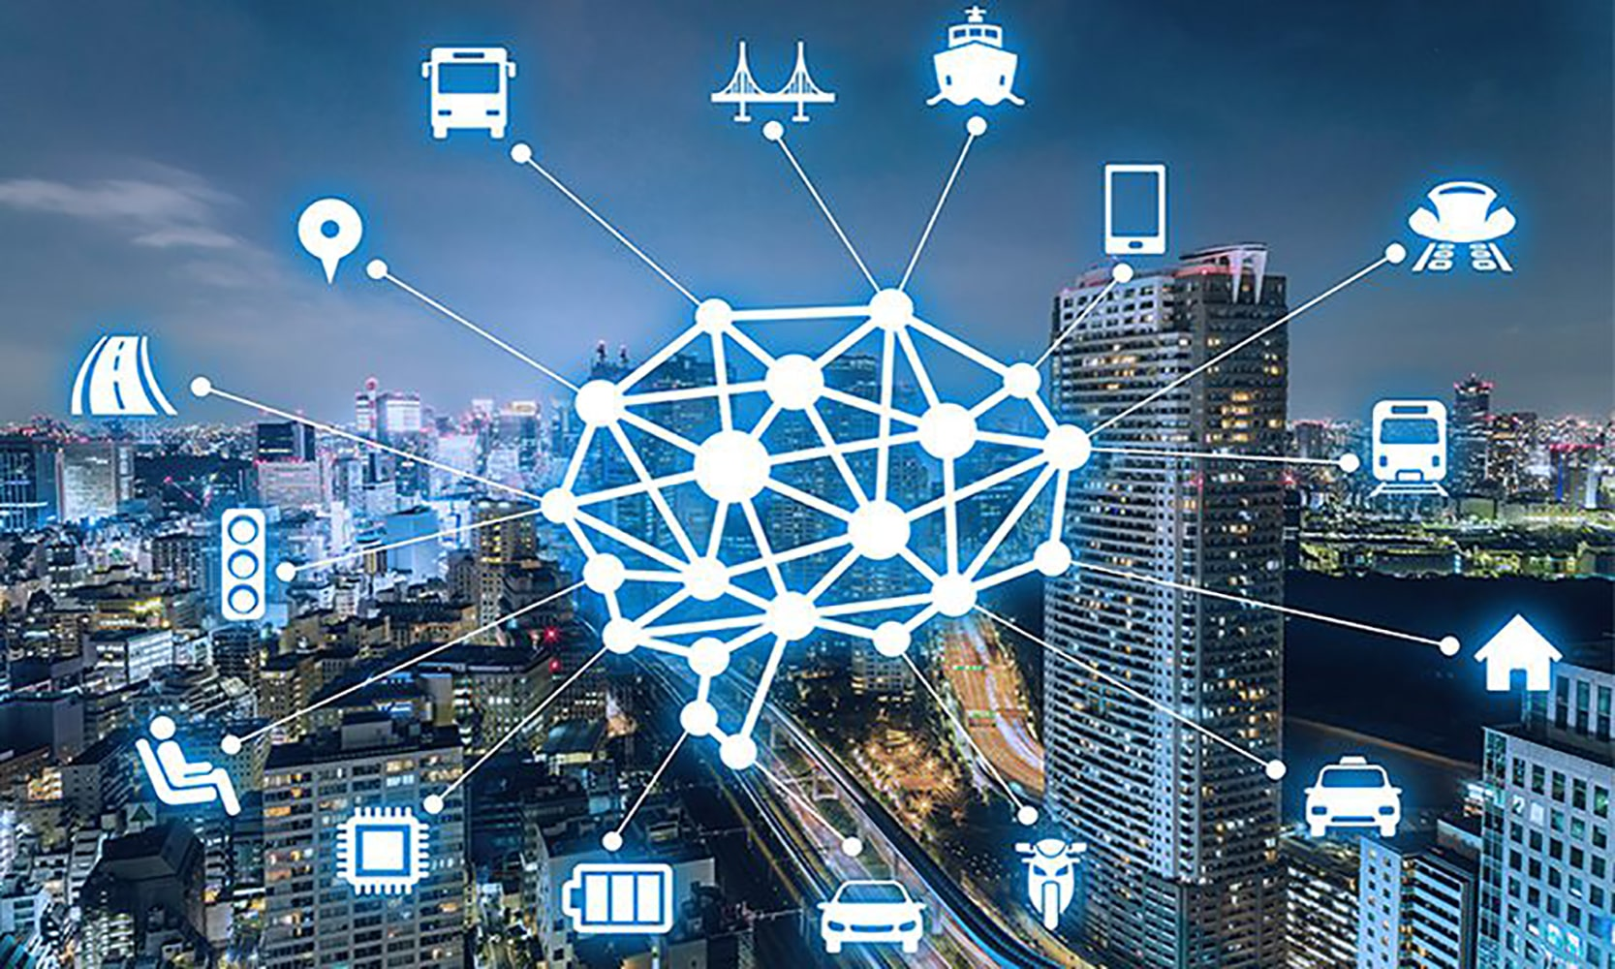
Transportation
Ambient intelligence can be used intelligent traffic management systems, smart parking solutions, and connected vehicles that communicate with each other and infrastructure to improve road safety and efficiency.

Slide 28
Transportation
Ambient intelligence can be used intelligent traffic management systems, smart parking solutions, and connected vehicles that communicate with each other and infrastructure to improve road safety and efficiency.
Notes:
Transportation can use ambient intelligence by using smart technology to make travel easier and safer. For example, traffic lights could adjust based on real-time traffic flow, and public transportation systems could provide updates on arrivals and delays through mobile apps.

Slide 29
Application and Use Cases
Smart Home
Health Care
Transportation

Slide 30
Introduction
Topic Content
Enabling Technology
Application and Use Cases
Benefits and Advantages
Limitation and Challenges
Conclusion

Slide 31
Benefits and Advantages
Enhance Safety
Enhanced User Experience
Improved Efficiency
Improved Health and Wellbeing

Slide 32
Benefits and Advantages
Enhance Safety
Enhanced User Experience
Improved Efficiency
Improved Health and Wellbeing

Slide 33
Enhanced User Experience
Enhance Safety
Enhanced safety with ambient intelligence means that smart systems are watching out for potential dangers and can react to keep people safe.
It preforms tasks automatically according to the requirement of the user and it does not any command to perform the tasks
Notes:
example of enhance safety, sensors in a smart home could detect smoke from a fire and automatically alert emergency services, helping to prevent harm to the occupants.
Example Enhanced User Experience:
a smart home adjusting the lighting and temperature based on your habits and preferences without you needing to do anything. This makes living in that home more comfortable and convenient, improving your overall experience.

Slide 34
Enhanced User Experience
Enhance Safety
Enhanced safety with ambient intelligence means that smart systems are watching out for potential dangers and can react to keep people safe.
It preforms tasks automatically according to the requirement of the user and it does not any command to perform the tasks
Notes:
example of enhance safety, sensors in a smart home could detect smoke from a fire and automatically alert emergency services, helping to prevent harm to the occupants.
Example Enhanced User Experience:
a smart home adjusting the lighting and temperature based on your habits and preferences without you needing to do anything. This makes living in that home more comfortable and convenient, improving your overall experience.

Slide 35
Enhance Safety
Enhanced User Experience
Enhanced safety with ambient intelligence means that smart systems are watching out for potential dangers and can react to keep people safe.
It preforms tasks automatically according to the requirement of the user and it does not any command to perform the tasks
Notes:
example of enhance safety, sensors in a smart home could detect smoke from a fire and automatically alert emergency services, helping to prevent harm to the occupants.
Example Enhanced User Experience:
a smart home adjusting the lighting and temperature based on your habits and preferences without you needing to do anything. This makes living in that home more comfortable and convenient, improving your overall experience.

Slide 36
Enhance Safety
Enhanced User Experience
Enhanced safety with ambient intelligence means that smart systems are watching out for potential dangers and can react to keep people safe.
It preforms tasks automatically according to the requirement of the user and it does not any command to perform the tasks
Notes:
example of enhance safety, sensors in a smart home could detect smoke from a fire and automatically alert emergency services, helping to prevent harm to the occupants.
Example Enhanced User Experience:
a smart home adjusting the lighting and temperature based on your habits and preferences without you needing to do anything. This makes living in that home more comfortable and convenient, improving your overall experience.

Slide 37
Benefits and Advantages​
Enhance Safety
Enhanced User Experience
Improved Efficiency
Improved Health and Wellbeing

Slide 38
Improved Health and Wellbeing ​
Improved Efficiency
Ambient intelligence systems can be designed to promote healthier lifestyles, facilitate better medical monitoring and care, and generally enhance the overall quality of life for individuals and communities.
Ambient intelligence systems can automate and optimize various processes, leading to increased productivity, reduce energy consumption, and better resource management.
Notes:
Example of improve efficiency, smart systems can automate tasks like adjusting room temperature or turning off lights when not needed, saving time and energy.
Example of improved of health and wellbeing, it can remind us to take medication, track our exercise habits, and adjust our environment to promote better sleep and relaxation.

Slide 39
Improved Health and Wellbeing ​
Improved Efficiency
Ambient intelligence systems can be designed to promote healthier lifestyles, facilitate better medical monitoring and care, and generally enhance the overall quality of life for individuals and communities.
Ambient intelligence systems can automate and optimize various processes, leading to increased productivity, reduce energy consumption, and better resource management.
Notes:
Example of improve efficiency, smart systems can automate tasks like adjusting room temperature or turning off lights when not needed, saving time and energy.
Example of improved of health and wellbeing, it can remind us to take medication, track our exercise habits, and adjust our environment to promote better sleep and relaxation.

Slide 40
Improved Efficiency
Improved Health and Wellbeing ​
Ambient intelligence systems can automate and optimize various processes, leading to increased productivity, reduce energy consumption, and better resource management.
Ambient intelligence systems can be designed to promote healthier lifestyles, facilitate better medical monitoring and care, and generally enhance the overall quality of life for individuals and communities.
Notes:
Example of improve efficiency, smart systems can automate tasks like adjusting room temperature or turning off lights when not needed, saving time and energy.
Example of improved of health and wellbeing, it can remind us to take medication, track our exercise habits, and adjust our environment to promote better sleep and relaxation.

Slide 41
Improved Efficiency
Improved Health and Wellbeing ​
Ambient intelligence systems can automate and optimize various processes, leading to increased productivity, reduce energy consumption, and better resource management.
Ambient intelligence systems can be designed to promote healthier lifestyles, facilitate better medical monitoring and care, and generally enhance the overall quality of life for individuals and communities.
Notes:
Example of improve efficiency, smart systems can automate tasks like adjusting room temperature or turning off lights when not needed, saving time and energy.
Example of improved of health and wellbeing, it can remind us to take medication, track our exercise habits, and adjust our environment to promote better sleep and relaxation.

Slide 42
Benefits and Advantages​
Enhance Safety
Enhanced User Experience
Improved Efficiency
Improved Health and Wellbeing

Slide 43
Introduction
Topic Content
Enabling Technology
Application and Use Cases
Benefits and Advantages
Limitation and Challenges
Conclusion

Slide 44
Limitation and Challenges
Privacy and Security
Technological Complexity
Energy Efficiency
Expensive

Slide 45
Limitation and Challenges
Privacy and Security
Technological Complexity
Energy Efficiency
Expensive

Slide 46
Privacy and Security
Technological Complexity​
AMI use huge amount of personal data from various source to perform the task effectively but there is high chance of misusing of personal data by the unauthorized person.
Implementing ambient intelligence systems requires the integration of various technologies, including sensors, connectivity, and AI, which can be technically challenging to use and to implement .
Notes:
Example of privacy and security : the unauthorized personal can be able to access the camera of smart home which records our daily activity and the hacker can use these data which can violate our privacy

Slide 47
Technological Complexity​
Privacy and Security​
AMI use huge amount of personal data from various source to perform the task effectively but there is high chance of misusing of personal data by the unauthorized person.
Implementing ambient intelligence systems requires the integration of various technologies, including sensors, connectivity, and AI, which can be technically challenging to use and to implement .
Notes:
Example of privacy and security : the unauthorized personal can be able to access the camera of smart home which records our daily activity and the hacker can use these data which can violate our privacy

Slide 48
Privacy and Security​
Technological Complexity​
AMI use huge amount of personal data from various source to perform the task effectively but there is high chance of misusing of personal data by the unauthorized person.
Implementing ambient intelligence systems requires the integration of various technologies, including sensors, connectivity, and AI, which can be technically challenging to use and to implement .
Notes:
Example of privacy and security : the unauthorized personal can be able to access the camera of smart home which records our daily activity and the hacker can use these data which can violate our privacy

Slide 49
Privacy and Security​
Technological Complexity​
Implementing ambient intelligence systems requires the integration of various technologies, including sensors, connectivity, and AI, which can be technically challenging to use and to implement .
AMI use huge amount of personal data from various source to perform the task effectively but there is high chance of misusing of personal data by the unauthorized person.
Notes:
Example of privacy and security : the unauthorized personal can be able to access the camera of smart home which records our daily activity and the hacker can use these data which can violate our privacy

Slide 50
Limitation and Challenges
Privacy and Security
Technological Complexity
Energy Efficiency
Expensive

Slide 51
Energy Efficiency​
Expensive ​
Many AMI devices are expected to operate continuously in the background, which can lead to significant energy consumption.
It is expensive to install and maintain .The hardware and software uses in AMI is also expensive
Notes:
Example of energy efficiency : The sensor is always on to detect the human activities and run in the background which uses the energy continuously .
Extra of expensive: it required a time to time Maintenace and experts to fit it which is also exoensive

Slide 52
Energy Efficiency​
Expensive ​
Many AMI devices are expected to operate continuously in the background, which can lead to significant energy consumption.
It is expensive to install and maintain .The hardware and software uses in AMI is also expensive
Notes:
Example of energy efficiency : The sensor is always on to detect the human activities and run in the background which uses the energy continuously .
Extra of expensive: it required a time to time Maintenace and experts to fit it which is also exoensive

Slide 53
Energy Efficiency​
Expensive ​
Many AMI devices are expected to operate continuously in the background, which can lead to significant energy consumption.
It is expensive to install and maintain .The hardware and software uses in AMI is also expensive
Notes:
Example of energy efficiency : The sensor is always on to detect the human activities and run in the background which uses the energy continuously .
Extra of expensive: it required a time to time Maintenace and experts to fit it which is also exoensive

Slide 54
Energy Efficiency​
Expensive ​
Many AMI devices are expected to operate continuously in the background, which can lead to significant energy consumption.
It is expensive to install and maintain .The hardware and software uses in AMI is also expensive
Notes:
Example of energy efficiency : The sensor is always on to detect the human activities and run in the background which uses the energy continuously .
Extra of expensive: it required a time to time Maintenace and experts to fit it which is also exoensive

Slide 55
Limitation and Challenges
Privacy and Security
Technological Complexity
Energy Efficiency
Expensive

Slide 56
Introduction
Topic Content
Enabling Technology
Application and Use Cases
Benefits and Advantages
Limitation and Challenges
Conclusion

Slide 57
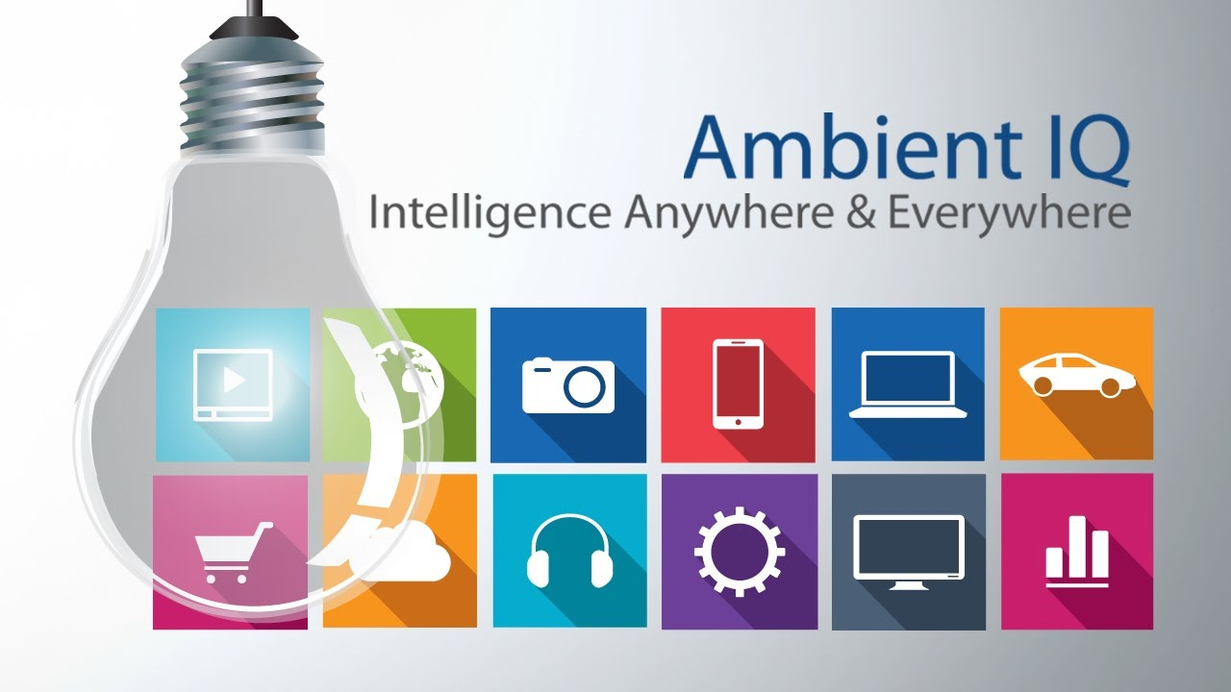
Conclusion
AMI is the future of human society. IT combines many technology which are high advance such as AI and Sensors. It is easier and effective to use . It helps to create a comfortable environment according to the user requirements.
Notes:
It offers numerous benefits such as security and safety Whereas , there are some disadvantage of using it such as it is expensive

Slide 58
Conclusion
AMI is the future of human society. IT combines many technology which are high advance such as AI and Sensors. It is easier and effective to use . It helps to create a comfortable environment according to the user requirements.
Notes:
It offers numerous benefits such as security and safety Whereas , there are some disadvantage of using it such as it is expensive

Slide 59

Any Queries
Thank​
You​

